Slide 1

Prognostics Modelling for Engine Degradation
Lorenzo Castro Ventas – Master Data Science Kschool TFM

Slide 2
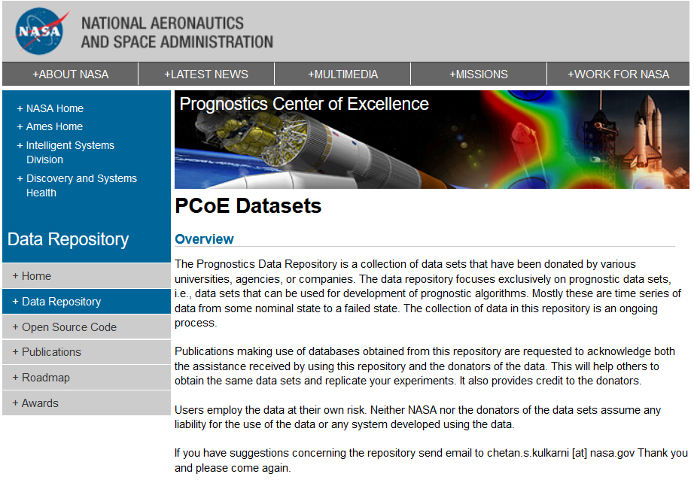
Dataset Acquisition
- 4 run-to-failure trajectories dataset(100 engines each)
- 4 unfinished trajectories dataset (100 engines each)
- 4 real remaining useful life numbers to validate
Levels of fidelity incorporated:
Real flight conditions
Different types of failure

Slide 3
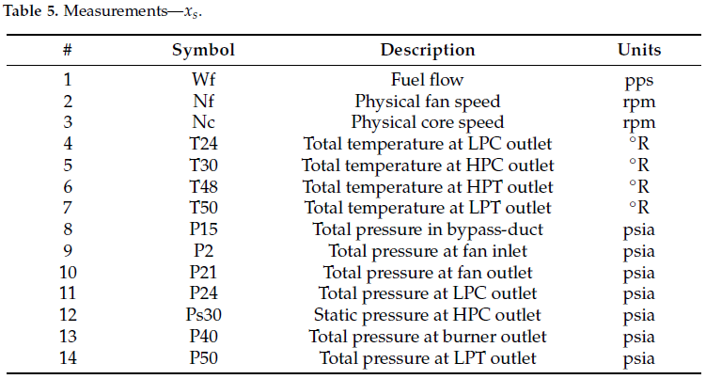
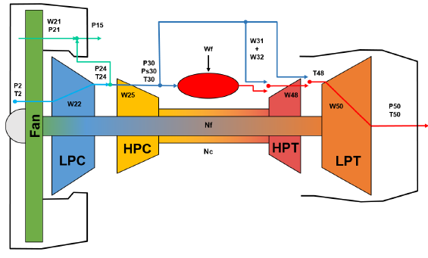
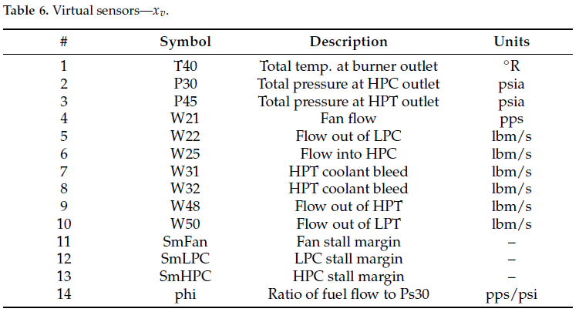
Dataset Analysis
Engine operating conditions and component performance sensors are the variables of this study

Slide 4
Current Project Status
4. FrontEnd and Visualizations
- Plot y_pred VS y_true (for both models)
- Started developing AppWeb in streamlit with slightly interactive interface
- Final model plots
- Develop Interactive interface in Streamlit with editable inputs
1. Data acquisition and understanding
- Datasources identification
- Understanding of data
- Literature Review
- Dive into deeper literature (complex NN definition)
3. Machine Learning development and testing
- First Linear Regression Model
- RandomForestRegressor
- Keep adjusting with more accurate ML
- Introduce DL: LSTM, CNN
- Classification of failure
2. Data wrangling, cleaning and featuring
- First approach with no data customization
- NaN cleaning
- Features analysis and filtering
- Advance feature engineering: PCA, new dataset variables

Slide 5
Higher priority tasks
Advanced feature engineering
Neural Networks development
Introduce Classification ML
Design interactive frontend in Streamlit
Crucial doubts
Advanced feature engineering
Neural Networks development
Introduce Classification ML
Design interactive frontend in Streamlit

Slide 6
Thanks for your attention

